Slide 1
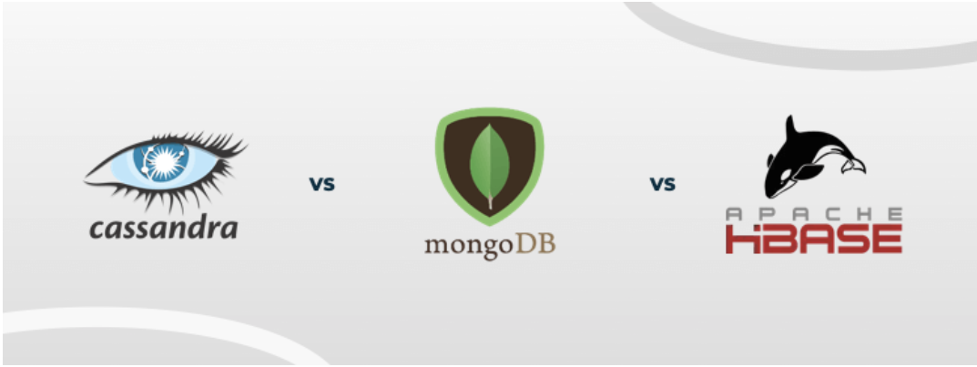

Slide 2
Need for NO SQL DB
Capable of running on a large number of nodes.
Non locking concurrency Mechanism.
Scalable Replication & Distribution
Schema-less Data Model
Types :
Key-value Store ()Hashtable of key and value: Amazon S3
Column-based Store ()Column: HBAse, Cassandra
Document-based Store()Tag element : Couch DB , Mongo DB
Graph-based Store ()Edges&nodes: neo4j

Slide 3
Cassandra
Scalability and high availability
Cassandra offers synchronous and asynchronous replication for each update
Unlike MongoDB, Cassandra uses a masterless “ring” architecture which provides several benefits over legacy architectures like master-slave architecture. Means all nodes in a cluster are treated equally, and a majority of nodes can be used to achieve quorum.
allows rows to have different columns, and even allows a change in the format of the columns.
Cassandra Query Language (CQL), closely resembles the traditional SQL syntax.
highly available and reliable.

Slide 4
MongoDB
MongoDB is a schema-less database and stores data as JSON-like documents.
flexibility and agility in the type of records that can be stored. Even the fields can vary from one document to the other.
high availability and horizontal scalability.
It uses the MongoDB query language to allow access to the stored data.

Slide 5
HBASE
in-memory operation, compression, and Bloom filters.
HBase provides support for external APIs like Thrift, Avro, Scala, Jython, and REST
store large data sets, even billions of rows, and provide analysis in a short period.
hosted/distributed across commodity server hardware
HBase also has a leg up on Cassandra when it comes to consistency, as the reads and writes adhere to immediate consistency, compared to the eventual consistency in Cassandra.
Unlike Cassandra, HBase does not have a query language. one must use the JRuby-based HBase shell and technologies like Apache Hive (which, in turn, is based on MapReduce)

Slide 6
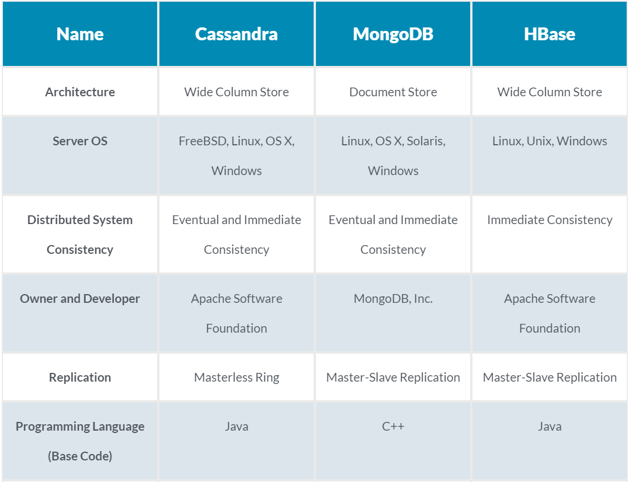

Slide 7
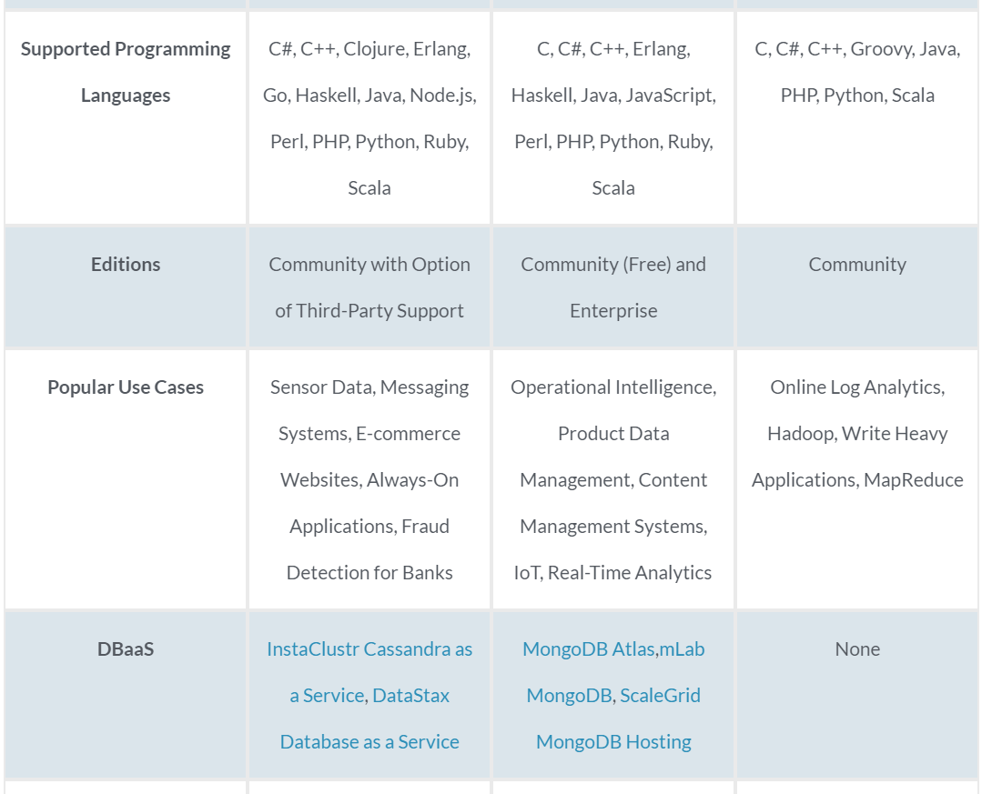

Slide 8
Business Requirement Synergy with Cassandra
One of Cassandra's greatest strengths is its ability to scale while still being reliable.
It is possible to deploy Cassandra across multiple servers built-in without a lot of extra work. Part of this is because Cassandra handles replication with minimal configuration, making it easy to set up.
If you need a database that is easy to setup and maintain regardless of how much your database grows, Cassandra can be a good option. If you work in an industry where you need rapid growth of your database, Cassandra offers easier rapid growth than MongoDB.

Slide 9
Business Requirement Synergy with Mongo DB
MongoDB can be a great choice if you need scalability and caching for real-time analytics; however, it is not built for transactional data (accounting systems, etc.).
MongoDB is frequently used for mobile apps, content management, real-time analytics, and applications involving the Internet Of Things.
If you have a situation where you have no clear schema definition, MongoDB can be a good choice.

Slide 10
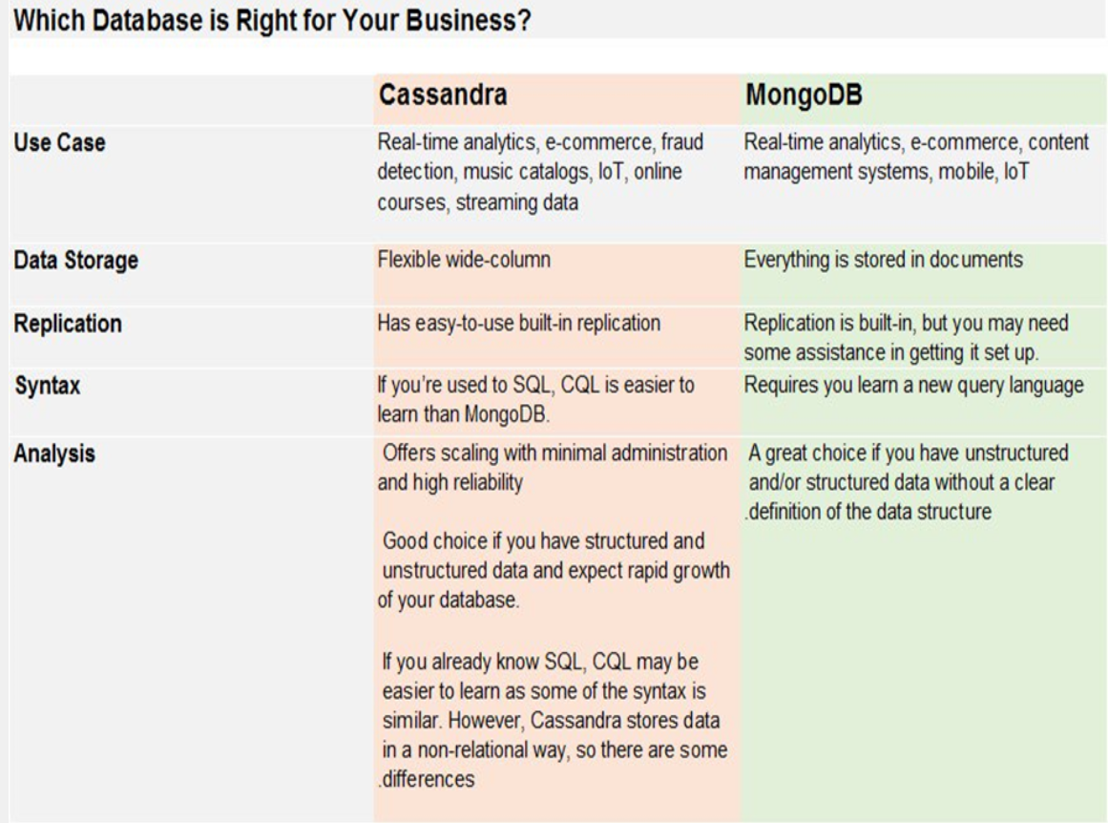

Slide 11
Key Things
Read/Writes:
Cassandra's storage engine provides constant-time writes no matter how big your data set grows. Writes are more problematic in MongoDB, partly because of the b-tree based storage engine, but more because of the multi-granularity locking it does.
Scalability:
If you're looking at a single server, MongoDB is probably a better fit. For those more concerned about scaling, Cassandra's no-single-point-of-failure architecture will be easier to set up and more reliable. Cassandra also gives a lot more control over how your replication works, including support for multiple data centers.
setup, maintenance and code :
Cassandra is simpler to set up in a multi-server configuration since there are no special-role nodes to worry about.
If you're presently using JSON blobs, MongoDB is an insanely good match for your use case, given that it uses BSON to store the data.

Slide 12
References
https://www.youtube.com/watch?v=QlqylUeqeis
https://academy.datastax.com/planet-cassandra/nosql-performance-benchmarks

